Slide 1






Home Credit
Risk Prediction
Data Science Project
By : Khalid Destiawan

Slide 2



Problem Research
Home Credit currently has many customers who want to know how eligible they are for loans. This project aimed to fully leverage existing data to predict which customers can repay loans, ensuring that those who are capable are not rejected when applying.
Additionally, it sought to predict and reject customers whose characteristics tend to lead to defaults, thereby reducing the company's losses.
Loans would be provided under conditions that meet regulations and align with targets. The evaluation was to be conducted by measuring the extent of the analysis performed. At least Two Machine Learning models were planned to be used, including Logistic Regression and Decision Tree.

Slide 3




GOAL
OBJECTIVE
METRICS
To Predict client that default on payment, and reduce company loss
Building a predictive model that can identify potential clients who can repay loans, as well as classify clients at risk of becoming defaulters.
Default Rate: The percentage of loans that go into default. A lower default rate indicates better model performance and risk assessment.

Slide 4



EDA
DATA PREPARATION
MODELING
Data PreProcessing
Bivariate
Multivariate
Missing Value
Feature Encoding
SMOTE
Train Model
Evaluate Model
Tune Model
Compare Model
Data Apllication Train
122
COLUMN
307.511
ROW
The data used consists of `application_train` and `application_test` datasets. These datasets are divided into two files: the training set, which includes the TARGET variable, and the test set, which does not.
The dataset contains various features related to borrower identity, credit information, property details, and additional information that may be relevant for predicting loan eligibility and default risk. This structured approach allows for effective model training and evaluation.
Data Apllication TEST
121
COLUMN
48.744
ROW

Slide 5


Data Visualization
Business Insight & Recommendation

Slide 6
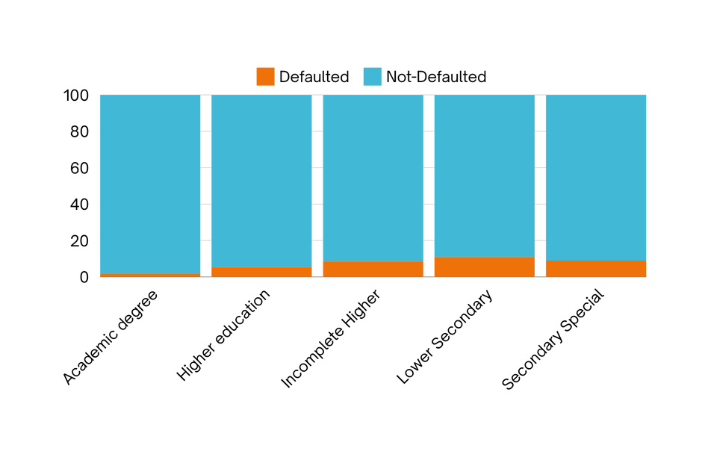
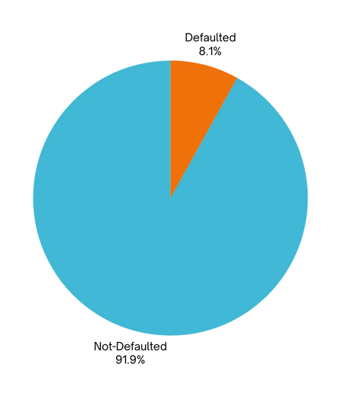
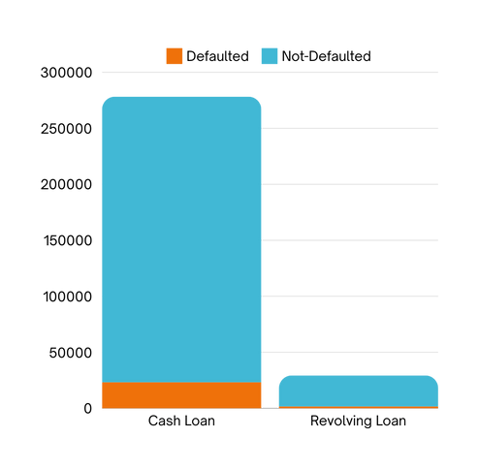
Business Insight & Recommendation
*Percentages for default rate
8.1%
1.83%
5.36%
8.48%
10.93%
8.94%
8.35%
5.48%
DEFAULT RATE
DEFAULT RATE OF CONTRACT TYPE
DEFAULT RATE OF EDUCATION TYPE
as seen from the pie chart. the default rate of this dataset is 8%.
thus we are dealing with imbalanced dataset.
from the analysis of contract_type features. can be concluded that the default rate on Cash loan slightly higher than Revolving loan, with total 278232 loans. recommendations could be, granting lower interest rate for revolving loan lending. this could lead to increase business revenue, as the default rate for this type of loan is lower
Borrowers with Higher Education have a 5.3% default rate, while Secondary Special borrowers face 8.2% among 218,391 individuals. To reduce defaults, we should invest in financial literacy programs and develop specialized loan products with lower interest rates for the Secondary Special demographic. Implementing mandatory financial education workshops will further enhance repayment rates and improve portfolio health.

Slide 7
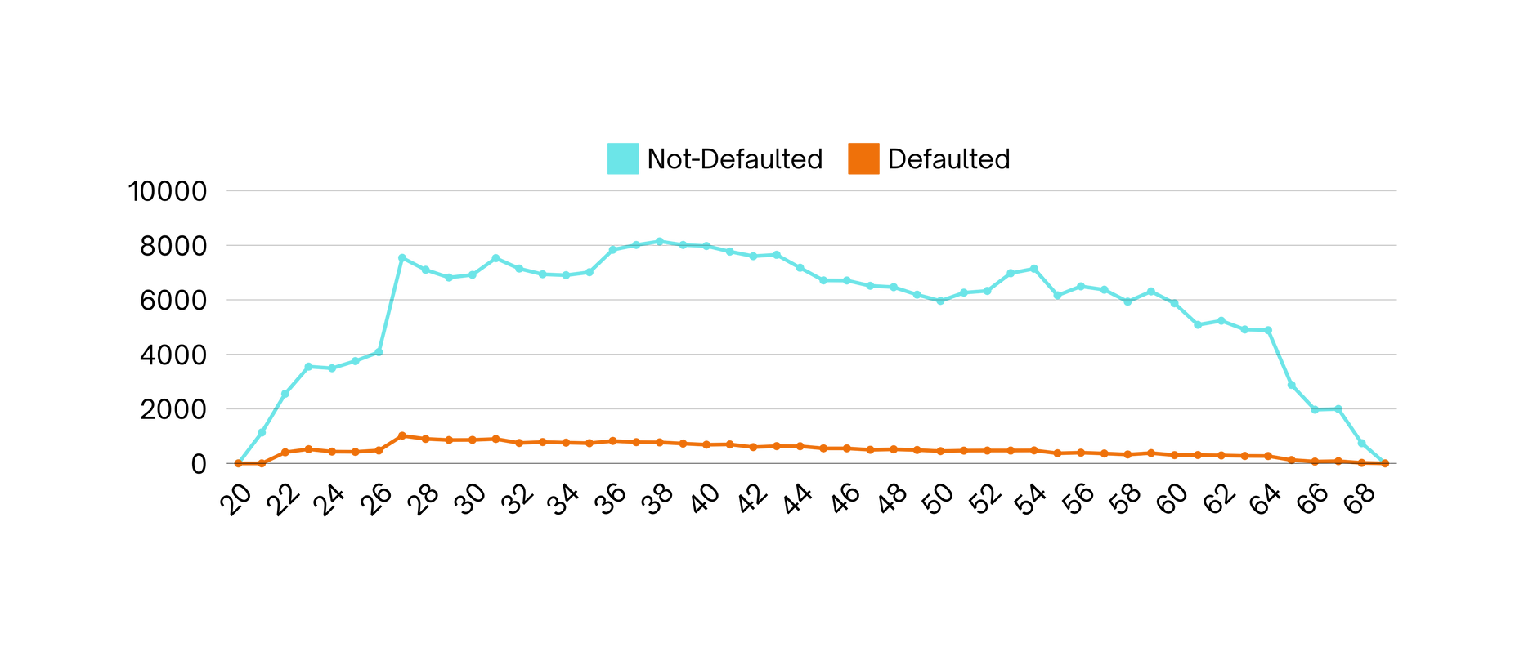


Business Insight & Recommendation
DEFAULT RATE TRENDS BY AGE
Recommendations
Default rates increase with age, peaking at 8.3% for ages 36-40.
Lower default rates are seen in the 20-30 age group.
Borrowers aged 65 and older have the fewest defaults, indicating greater financial stability.
Financial Literacy Programs: Implement targeted programs for borrowers aged 31-40 to reduce default risks.
Customized Loan Products: Create flexible loan options for the 31-40 age group to accommodate life changes.
Incentives for Older Borrowers: Offer lower interest rates for borrowers aged 65 and above with strong repayment histories.

Slide 8
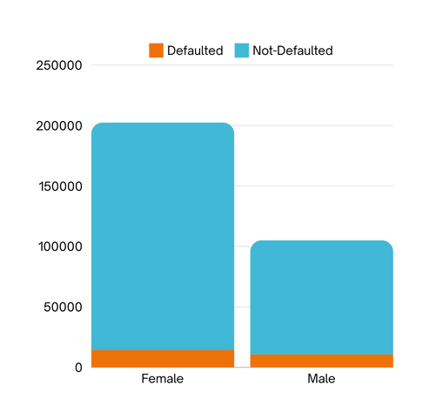
Business Insight & Recommendation
*Percentages for default rate
DEFAULT RATES BY GENDER
Female borrowers (F) have a lower default rate, with 7.0% (14,170 defaults) compared to male borrowers (M) at 10.1% (10,655 defaults).
Overall, there are more female borrowers (200,448) than male borrowers (105,059).
7%
10.14%
RECOMMENDATIONS
Targeted Marketing: Focus marketing efforts on female borrowers, as they demonstrate lower default rates, potentially enhancing loan portfolio performance.
Support Programs for Males: Develop financial literacy and support programs specifically for male borrowers, addressing the higher default rates.
Gender-Specific Loan Products: Consider creating tailored loan products for males, with features that cater to their financial behaviors and needs.

Slide 9

Machine Learning Implementation & Evaluation
Model Metrics
Model & Metrics Interpretation
Model | AUC | Recall
Tuned Logistic Regression | 70.2% | 58.6%
Tuned Decision Tree | 55.2% | 61.2%
The objective is to create a predictive model that identifies clients likely to repay loans and those at risk of default.
Key metrics include the default rate and true negatives. The model will be evaluated using AUC for its effectiveness in distinguishing between defaulters and non-defaulters.
Logistic Regression is selected for its high AUC, with a slight trade-off in recall for better overall predictive power.
Logistic Regression Confusion Matrix
Confusion Matrix
0
59706
25100
From the confusion matrix, the recall is 59.6%, indicating that the model misses approximately 40.4% of actual defaults (3,002 cases). This is critical, as failing to identify defaulting customers can have significant consequences.
However, with an AUC of 0.70, the model demonstrates reasonably good performance in risk assessment, effectively identifying potential defaulters. This supports informed lending decisions and allows the business to target high-risk customers appropriately.
Actual Class
1
3002
4446
0
1
Predicted Class

Slide 10




THANK YOU
CONTACT ME AT :
GITHUB REPO:

